Slide 1

Business Intelligence and Data Warehouses
Presented By:
Elizer Ponio Jr. Department of Computer Science
College of Computing and Information Technologies

Slide 2
Outline
Business Intelligence and Data Analytics
Data Warehouses
Multidimensional Analysis and Online Analytical Processing (OLAP)

Slide 3
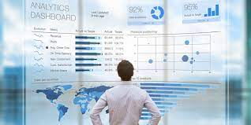
Business Intelligence
Business intelligence (BI) is a software that ingests business data and presents it in user-friendly views such as reports, dashboards, charts and graphs.
BI tools enable business users to access different types of data — historical and current, third-party and in-house, as well as semi-structured data and unstructured data like social media.
Users can analyze this information to gain insights into how the business is performing.

Slide 4
Business Intelligence
BI platforms traditionally rely on data warehouses for their baseline information.
Business intelligence software queries the warehouse and presents the results to the user in the form of reports, charts and maps.

Slide 5
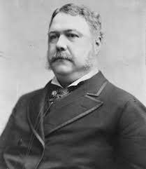

History of Business Intelligence
1865
The term business intelligence was first used in 1865 by author Richard Millar Devens, when he cited a banker who collected intelligence on the market ahead of his competitors.
1958
In 1958, an IBM computer scientist named Hans Peter Luhn explored the potential of using technology to gather business intelligence. His research helped establish methods for creating some of IBM’s early analytics platforms.

Slide 6
History of Business Intelligence
1960s and 1970s
In the 1960s and 70s, the first data management systems and decision support systems (DSS) were developed to store and organize growing volumes of data.
1990s
By the 1990s, business intelligence grew increasingly popular, but the technology was still complex. It usually required IT support — which often led to backlogs and delayed reports. Even without IT, business intelligence analysts and users needed extensive training to be able to successfully query and analyze their data.

Slide 7


History of Business Intelligence
Today
More recent development has focused on self-service BI applications, allowing non-expert users to benefit from their own reporting and analysis. Modern cloud-based platforms have also extended the reach of BI across geographies. Many solutions now handle big data and include real-time processing, enabling decision-making processes based on up-to-date information.

Slide 8

Data Analytics
Decision-making tasks benefit greatly by using data about the past to predict the future and using the predictions to make decisions.
For example, online advertisement systems need to decide what advertisement to show to each user.
Analysis of past actions and profiles of other users, as well as past actions and profile of the current user, are key to deciding which advertisement the user is most likely to respond to

Slide 9

Data Analytics
Predicting future demand of different types of items based on past sales and other indicators is key to avoiding both overproduction or overstocking of some items, and underproduction or understocking of other items.
Errors can lead to monetary loss due to unsold inventory of some items, or loss of potential revenue due to nonavailability of some items

Slide 10

Data Analytics
The term data analytics refers broadly to the processing of data to infer patterns, correlations, or models for prediction.
The results of analytics are then used to drive business decisions.

Slide 11

Data Analytics
The financial benefits of making correct decisions can be substantial, as can the costs of making wrong decisions.
Organizations therefore invest a lot of money to gather or purchase required data and build systems for data analytics

Slide 12
Outline
Business Intelligence and Data Analytics
Data Warehouses
Multidimensional Analysis and Online Analytical Processing (OLAP)

Slide 13
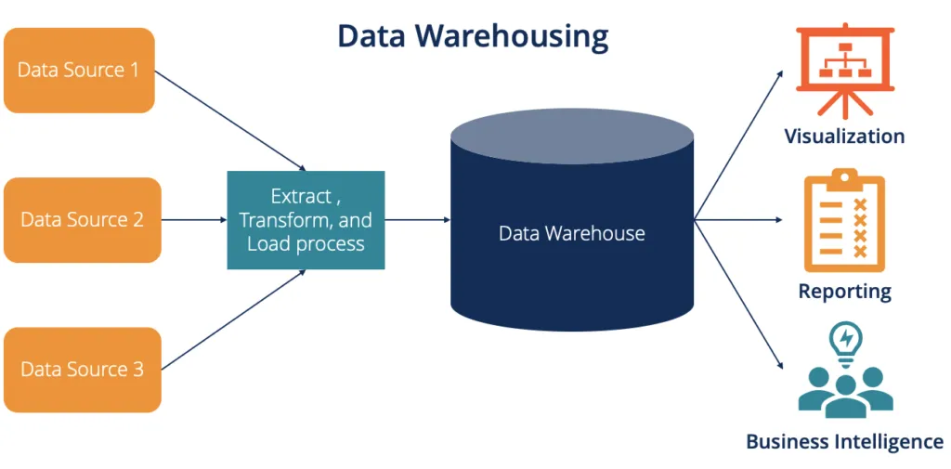
Data Warehouses
Large companies have diverse sources of data that they need to use for making business decisions.
The sources may store the data under different schemas.
For performance reasons (as well as for reasons of organization control), the data sources usually will not permit other parts of the company to retrieve data on demand.

Slide 14
Data Warehouses
Organizations therefore typically gather data from multiple sources into one location, referred to as a data warehouse.
Data warehouses gather data from multiple sources at a single site, under a unified schema Thus, they provide the user a single uniform interface to data.

Slide 15
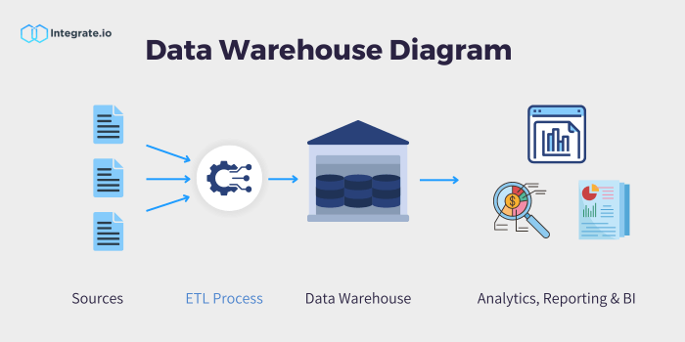
Data Warehouses
Data warehouses today also collect and store data from non-relational sources, where schema unification is not possible.
Organizations may collect data from multiple sources, and there may be duplicates in the data collected from different sources.

Slide 16
Data Warehouses
These steps of collecting data, cleaning/deduplicating the data, and loading the data into a warehouse are referred to as extract, transform and load (ETL) tasks.

Slide 17

Data Warehousing
Large organizations have a complex internal organization structure, and therefore different data may be present in different locations, or on different operational systems, or under different schemas.

Slide 18
Data Warehousing
For instance, manufacturing problem data and customer complaint data may be stored on different database systems.
Organizations often purchase data from external sources
Such as mailing lists that are used for product promotions, or credit scores of customers that are provided by credit bureaus, to decide on creditworthiness of customers.

Slide 19
Data Warehousing
Corporate decision makers require access to information from multiple such sources.
Setting up queries on individual sources is both cumbersome and inefficient.

Slide 20
Data Warehousing
Moreover, the sources of data may store only current data, whereas decision makers may need access to past data as well
For instance, information about how purchase patterns have changed in the past few years could be of great importance.
Data warehouses provide a solution to these problems.

Slide 21
Data Warehousing
A data warehouse is a repository (or archive) of information gathered from multiple sources, stored under a unified schema, at a single site.
Once gathered, the data are stored for a long time, permitting access to historical data.
Data warehouses provide the user a single consolidated interface to data, making decision-support queries easier to write.

Slide 22
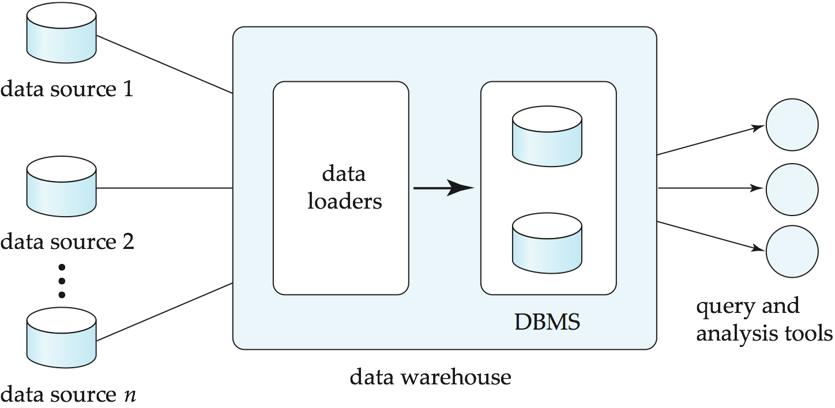
Components of a Data Warehouse

Slide 23
Issues when building a Data Warehouse
1. When and how to gather data
Source-driven architecture: Data sources transmit new information, either continually or periodically
Destination-driven architecture: The data warehouse periodically sends requests for new data to the sources.
Organizations wants up-to-date data as much as possible.
Synchronous replication is expense. Many data warehouses do not use this.
Traditionally, analysts were happy with using yesterday’s data, so data warehouses could be loaded with data up to the end of the previous day.
The data freshness requirements depend on the application. Data that are within a few hours old may be sufficient for some applications;

Slide 24
Issues when building a Data Warehouse
2. What schema to use
Data sources that have been constructed independently are likely to have different schemas or may even use different data models.
Part of the task of a warehouse is to perform schema integration and to convert data to the integrated schema before they are stored.
As a result, the data stored in the warehouse are not just a copy of the data at the sources. Instead, they can be thought of as a materialized view of the data at the sources.
(A materialized view is a duplicate data table created by combining data from multiple existing tables for faster data retrieval.)

Slide 25
Issues when building a Data Warehouse
3. Data transformation and cleansing
The task of correcting and preprocessing data is called data cleansing. Data sources often deliver data with numerous minor inconsistencies, which can be corrected.
For example, names are often misspelled, and addresses may have street, area, or city names misspelled, or postal codes entered incorrectly.
Address lists collected from multiple sources may have duplicates that need to be eliminated
Data may be transformed in ways other than cleansing, such as changing the units of measure, or converting the data to a different schema by joining data from multiple source relations.

Slide 26
Issues when building a Data Warehouse
4. How to propagate updates
Updates on relations at the data sources must be propagated to the data warehouse. If the relations at the data warehouse are exactly the same as those at the data source, the propagation is straightforward.
If they are not, the problem of propagating updates is basically the view-maintenance problem

Slide 27
Issues when building a Data Warehouse
5. What data to summarize?
The raw data generated by a transaction-processing system may be too large to store online.
However, we can answer many queries by maintaining just summary data obtained by aggregation on a relation, rather than maintaining the entire relation.
For example, instead of storing data about every sale of clothing, we can store total sales of clothing by item name and category.

Slide 28
Issues when building a Data Warehouse
The different steps involved in getting data into a data warehouse are called extract, transform, and load or ETL tasks
Extraction refers to getting data from the sources,
Load refers to loading the data into the data warehouse.
In current generation data warehouses that support user-defined functions or MapReduce frameworks.

Slide 29
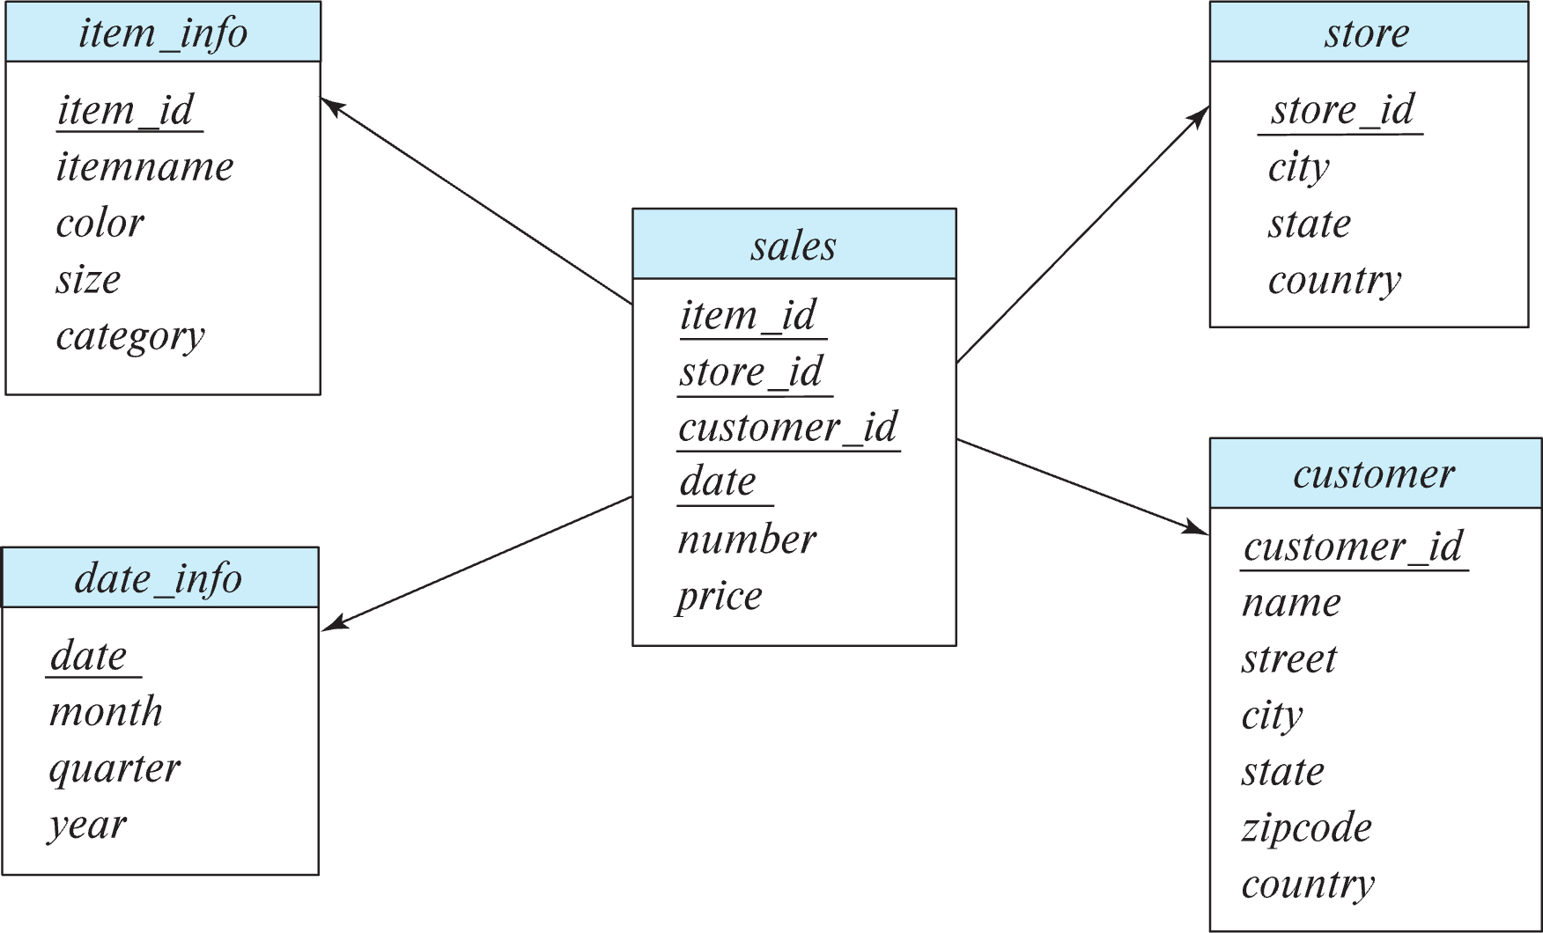
Warehouse Schemas
Data warehouses typically have schemas that are designed for data analysis.
The relations in a data warehouse schema can usually be classified as fact tables and dimension tables.
Fact tables record information about individual events, such as sales, and are usually very large.
A table recording sales information for a retail store, with one tuple for each item that is sold, is a typical example of a fact table.

Slide 30
Fact Table Attributes
The attributes in fact table can be classified as either dimension attributes or measure attributes.
The measure attributes store quantitative information, which can be aggregated.
Examples of measure attributes of a sales table would include the number of items sold and the price of the items.

Slide 31
Fact Table Attributes
In contrast, dimension attributes are dimensions upon which measure attributes, and summaries of measure attributes, are grouped and viewed.
The dimension attributes of a sales table would include:
An item identifier
The date when the item is sold
The location (store) the item was sold from.
The customer who bought the item.

Slide 32

Multidimensional Data and Dimension Tables
Data that can be modeled using dimension attributes and measure attributes are called multidimensional data.
To minimize storage requirements, dimension attributes are usually short identifiers that are foreign keys into other tables called dimension tables.

Slide 33
Star Schema
A schema, with a fact table, multiple dimension tables, and foreign keys from the fact table to the dimension tables is called a star schema.

Slide 34
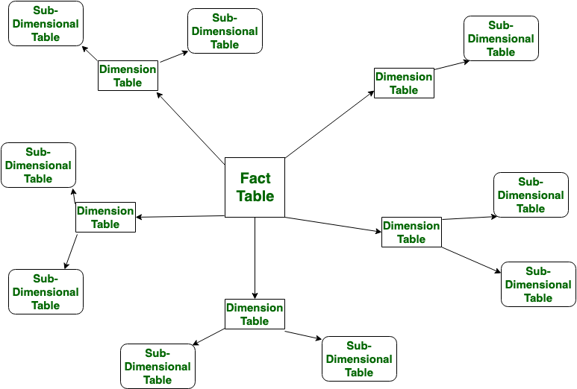
Snowflake Schema
In snowflake schema, the fact table, dimension tables and one or more than one sub-tables exists for each dimension table. Snowflake schema is a normalized form of star schema

Slide 35
Outline
Business Intelligence and Data Analytics
Data Warehouses
Multidimensional Analysis and Online Analytical Processing (OLAP)

Slide 36
Online Analytical Processing
The most basic form of analytics is generation of aggregates and reports summarizing the data in ways that are meaningful to the organization
Aggregates, and in some cases the underlying data, are typically presented graphically as charts, to make it easy for humans to visualize the data.

Slide 37
Online Analytical Processing
Dashboards that display charts summarizing key organizational parameters, such as sales, expenses, product returns, and so forth, are popular means of monitoring the health of an organization.
Analysts also need to visualize data in ways that can highlight anomalies or give insights into causes for changes in the business.

Slide 38
Online Analytical Processing
Systems that support very efficient analysis, where aggregate queries on large data are answered in almost real time (as opposed to being answered after tens of minutes or multiple hours) are popular with analysts.
Such systems are referred to as online analytical processing (OLAP)

Slide 39
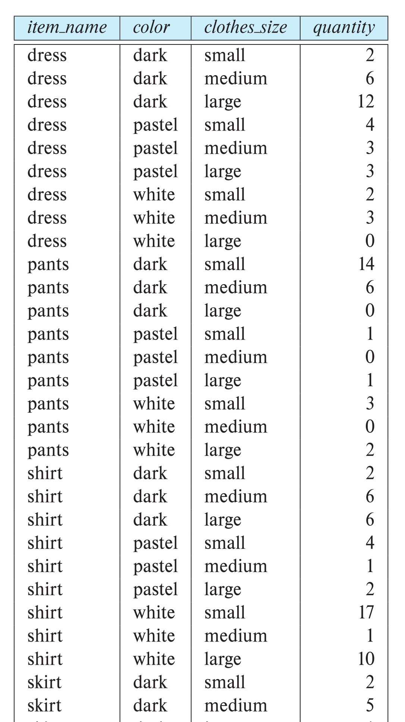
Multidimensional Data
Data analysis often involves looking for patterns that arise when data values are grouped in “interesting” ways.
In a retail business, we might group sales by product, the date or month of the sale, the color or size of the product, or the profile (such as age group and gender) of the customer who bought the product.

Slide 40
Multidimensional Data
Consider an application where a shop wants to find out what kinds of clothes are pop- ular.
Let us suppose that clothes are characterized by their item name, color, and size, and that we have a relation sales with the schema.

Slide 41
Multidimensional Data
To analyze the multidimensional data, a manager may want to see data laid out as shown in the table

Slide 42
Multidimensional Data
The table above is an example of a cross-tabulation (or cross-tab, for short), also referred to as a pivot-table.

Slide 43
Multidimensional Data
In general, a cross-tab is a table derived from a relation where values for one attribute form the column headers and values for another attribute form the row header.

Slide 44
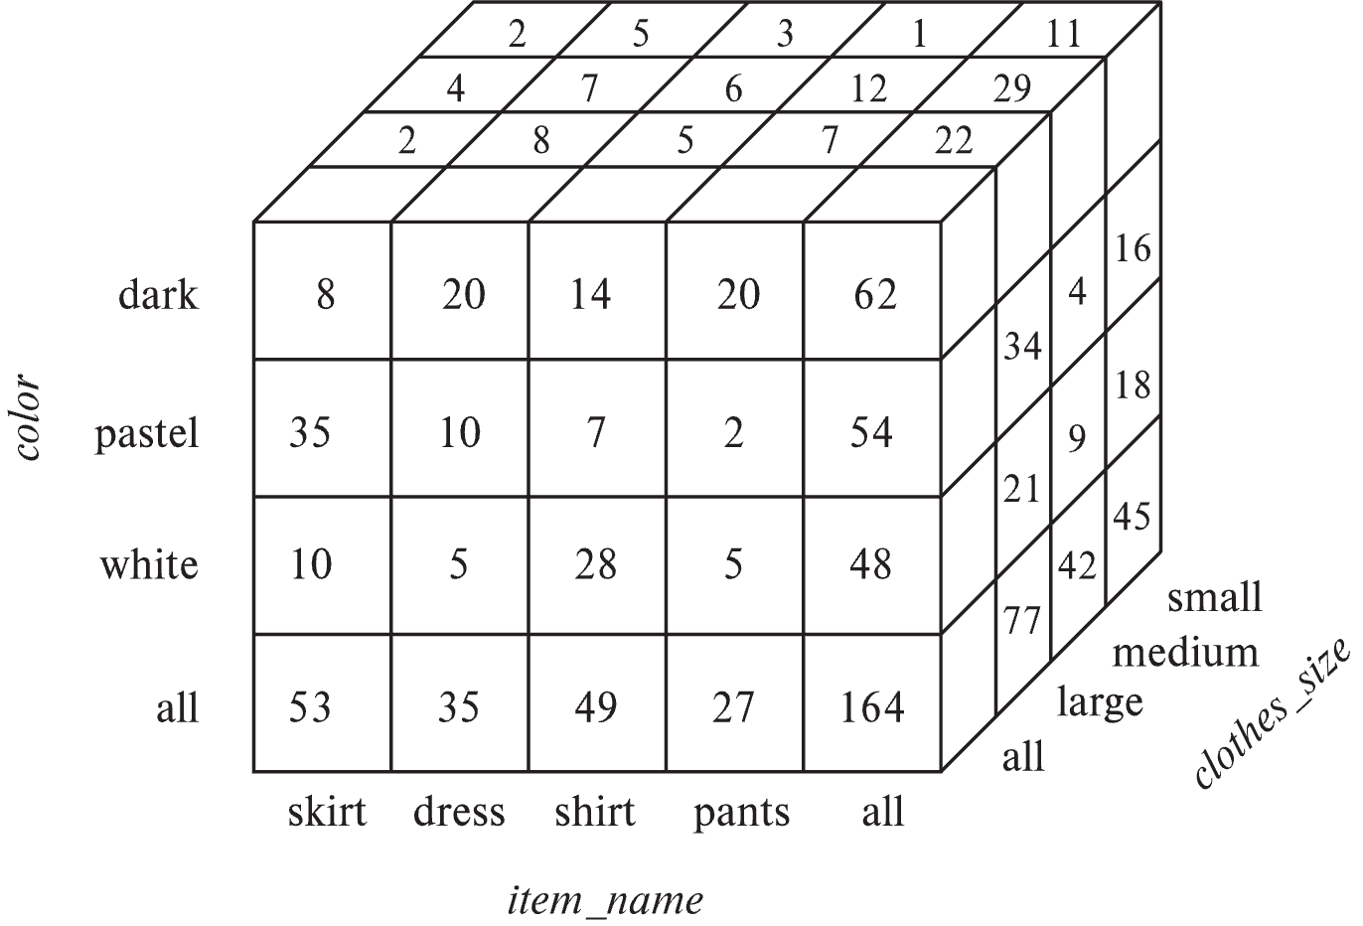
Multidimensional Data
The generalization of a cross-tab, which is two-dimensional, to n dimensions can
be visualized as an n-dimensional cube, called the data cube

Slide 45
Multidimensional Data
An online analytic processing (OLAP) system allows a data analyst to look at different cross-tabs on the same data by interactively selecting the attributes in the cross-tab.

Slide 46
Multidimensional Data
OLAP systems allow an analyst to see a cross-tab on item name and color for a fixed value of clothes size, for example, large, instead of the sum across all sizes. Such an operation is referred to as slicing, since it can be thought of as viewing a slice of the data cube.
The operation is sometimes called dicing, particularly when values for multiple dimensions are fixed.

Slide 47
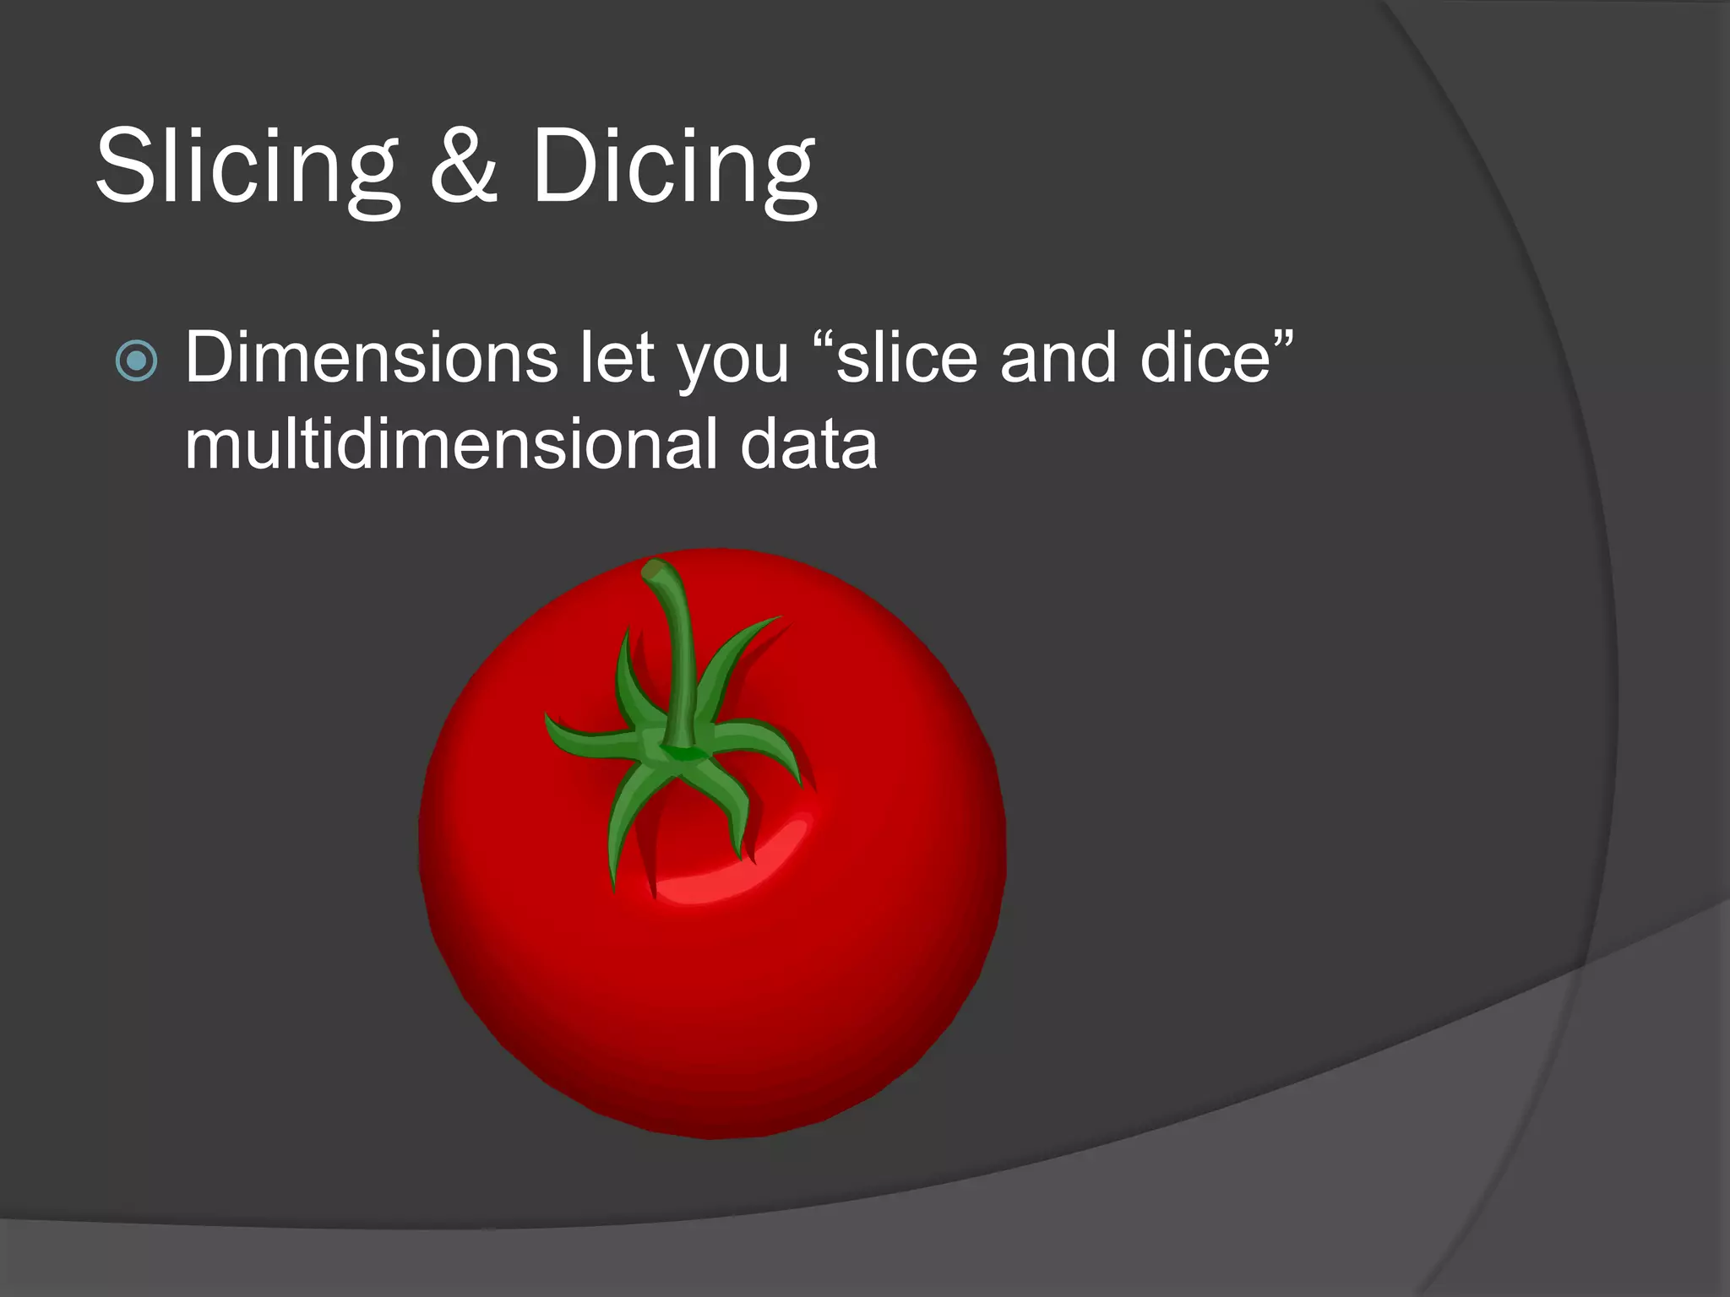

Slide 48
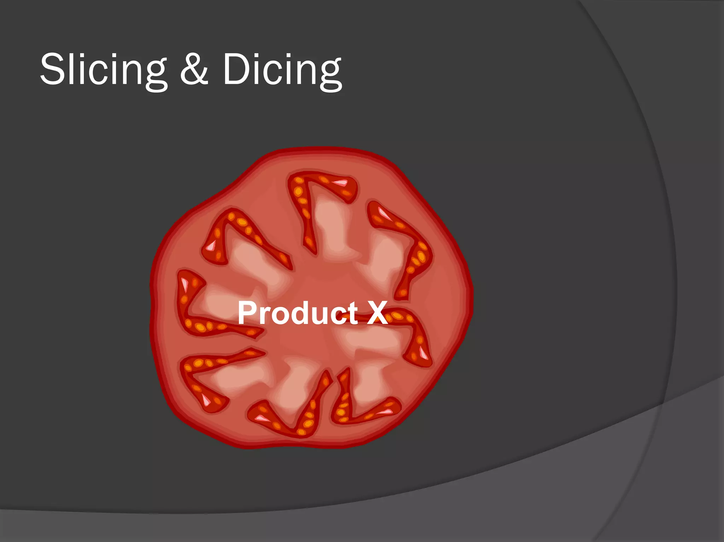

Slide 49
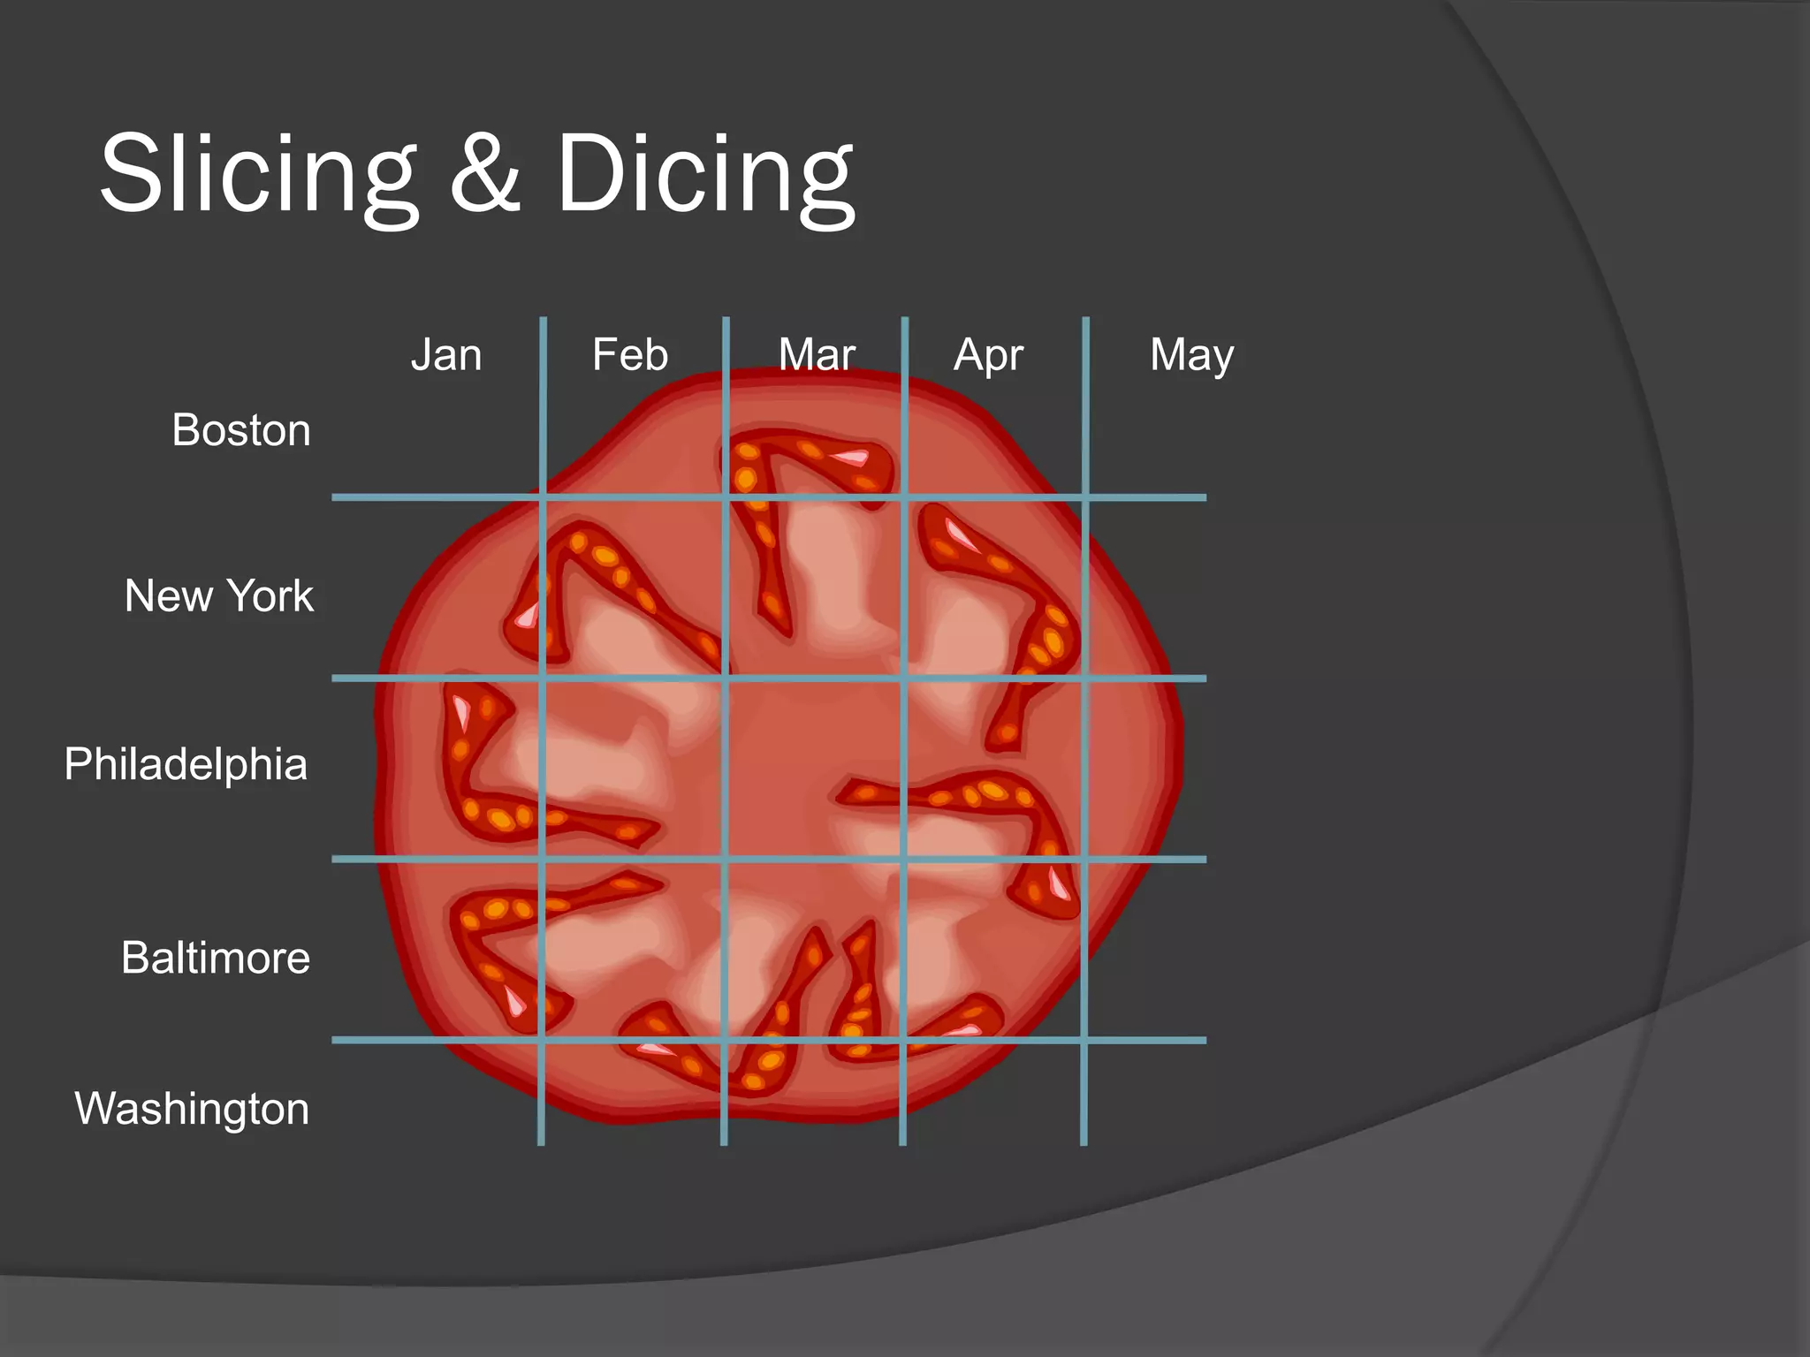

Slide 50
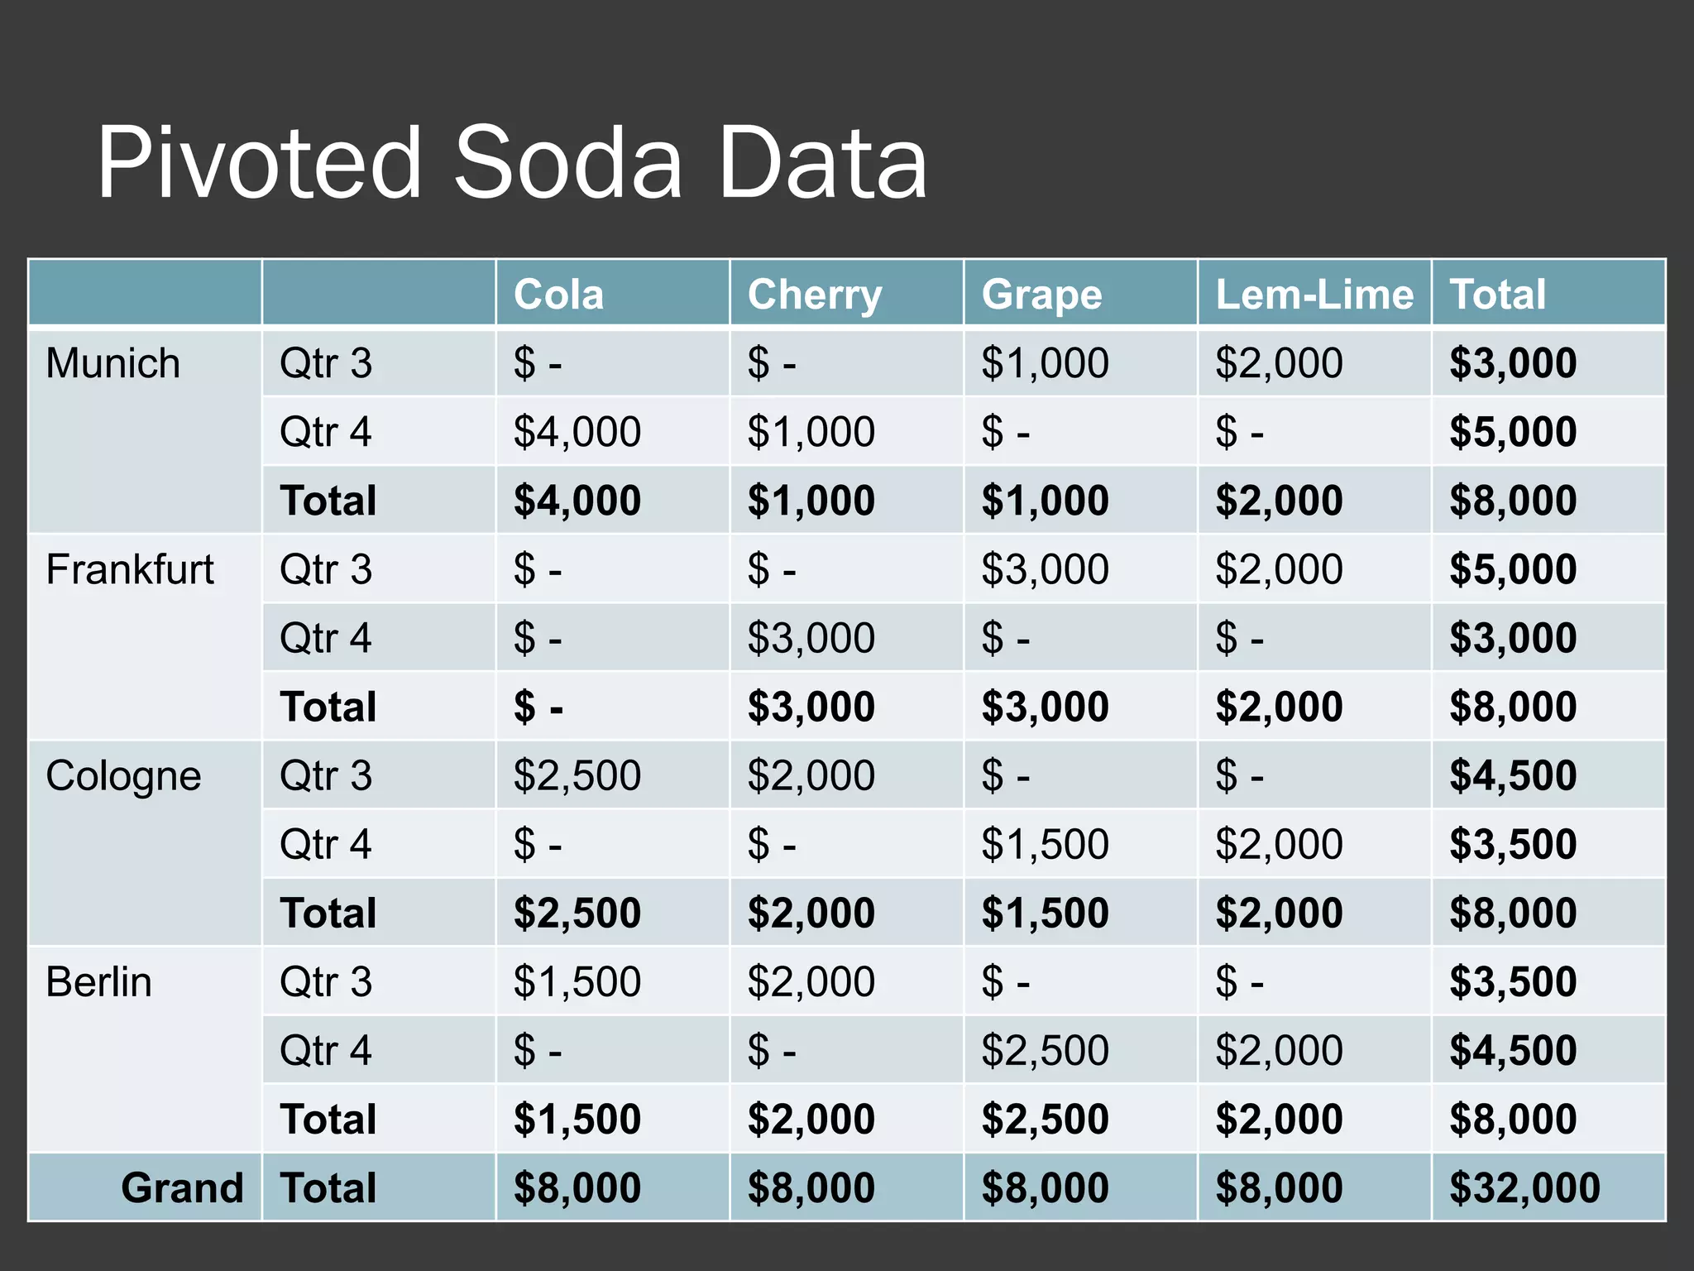

Slide 51
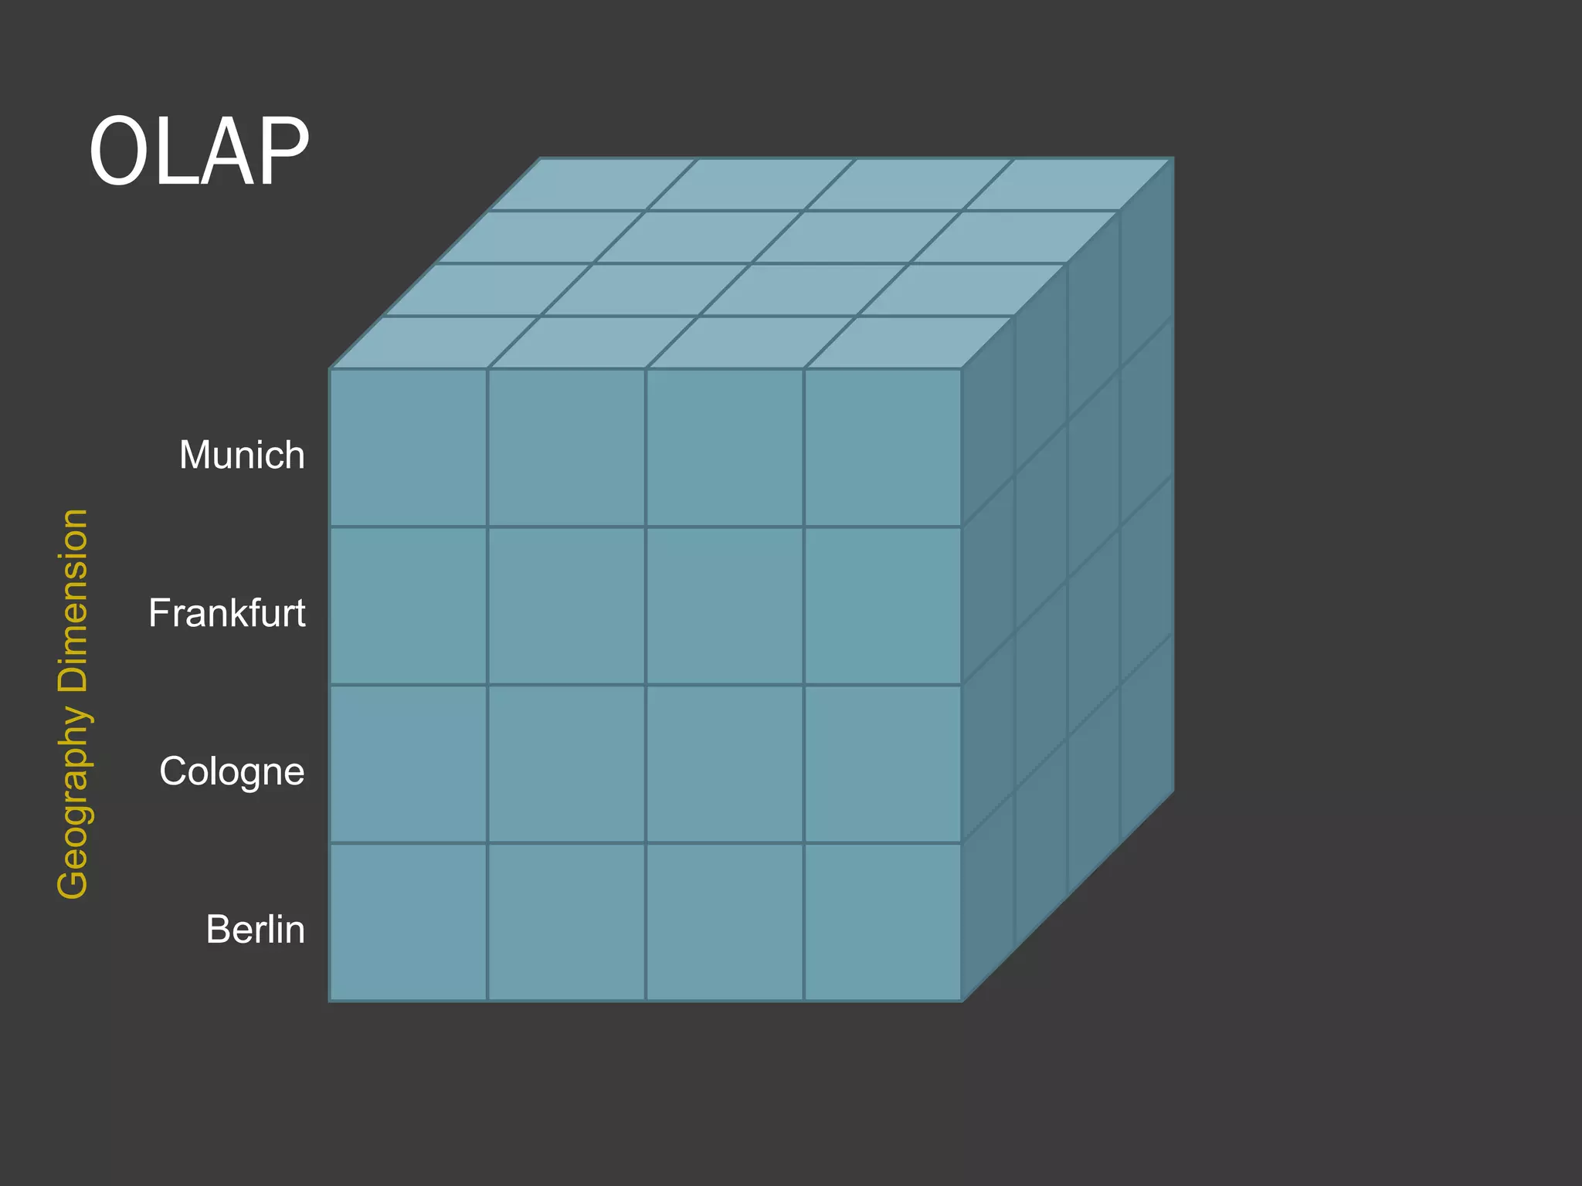

Slide 52
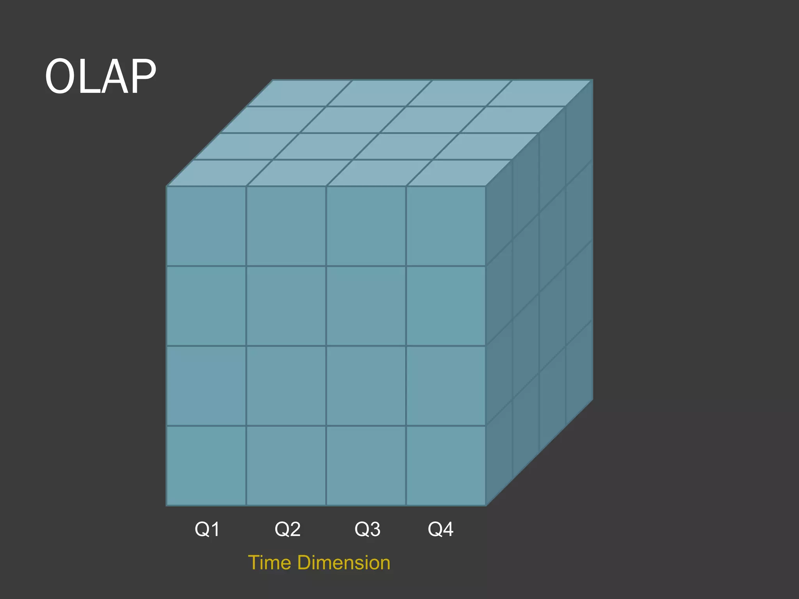

Slide 53
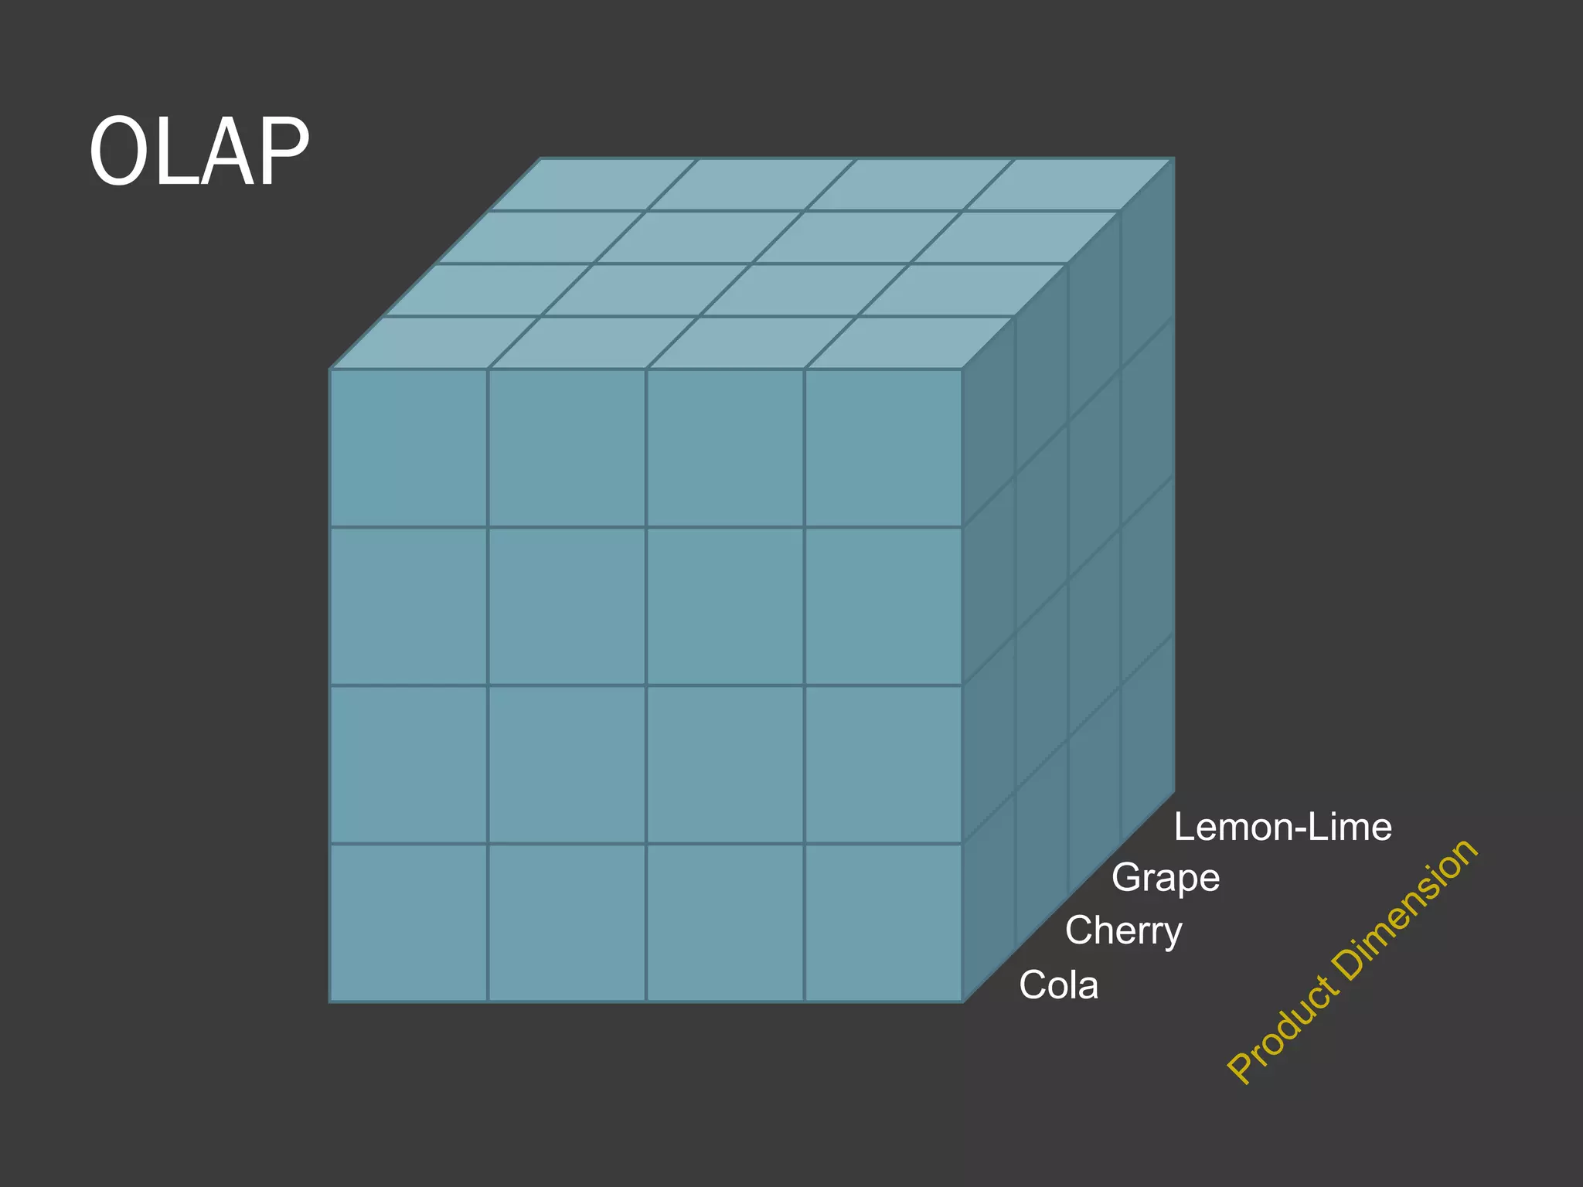

Slide 54
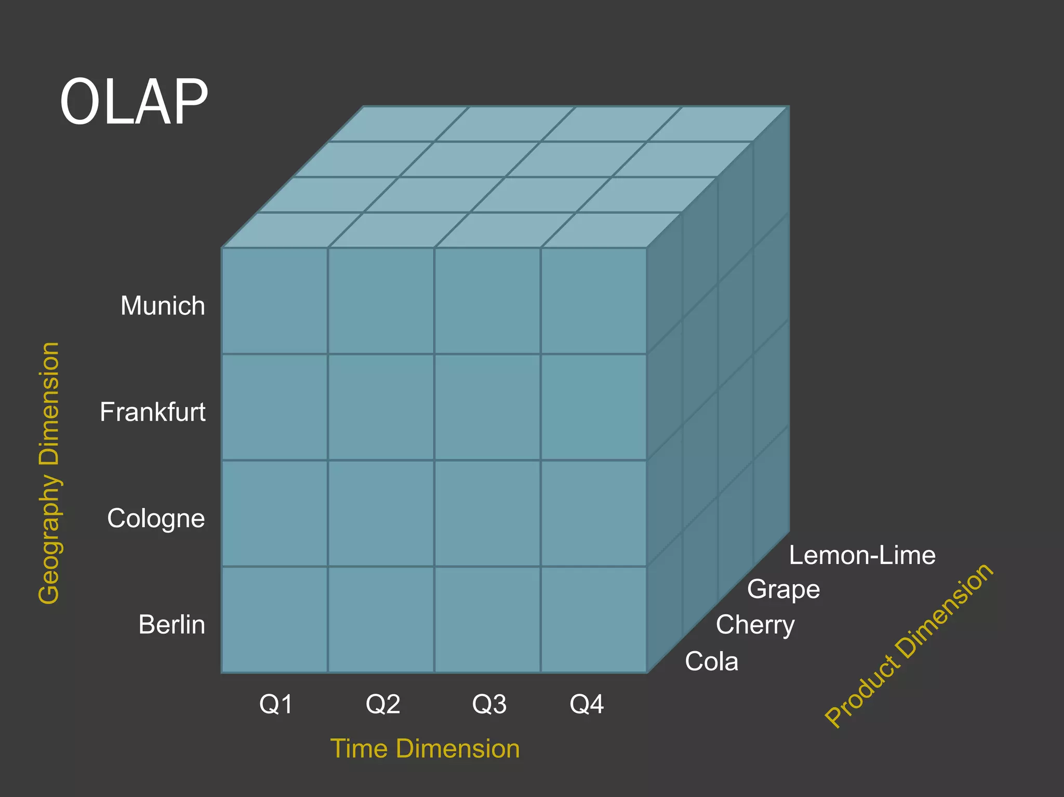

Slide 55
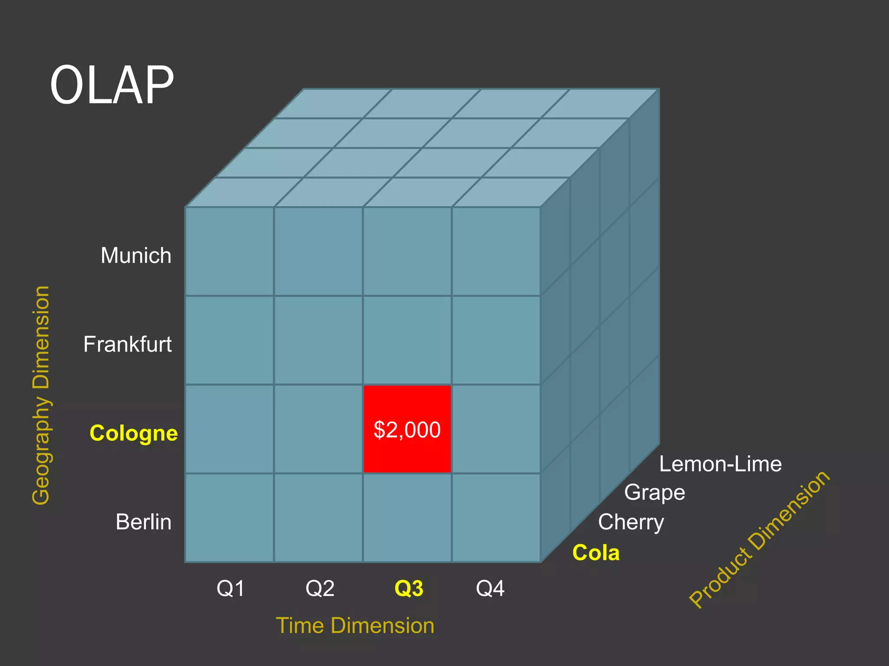

Slide 56
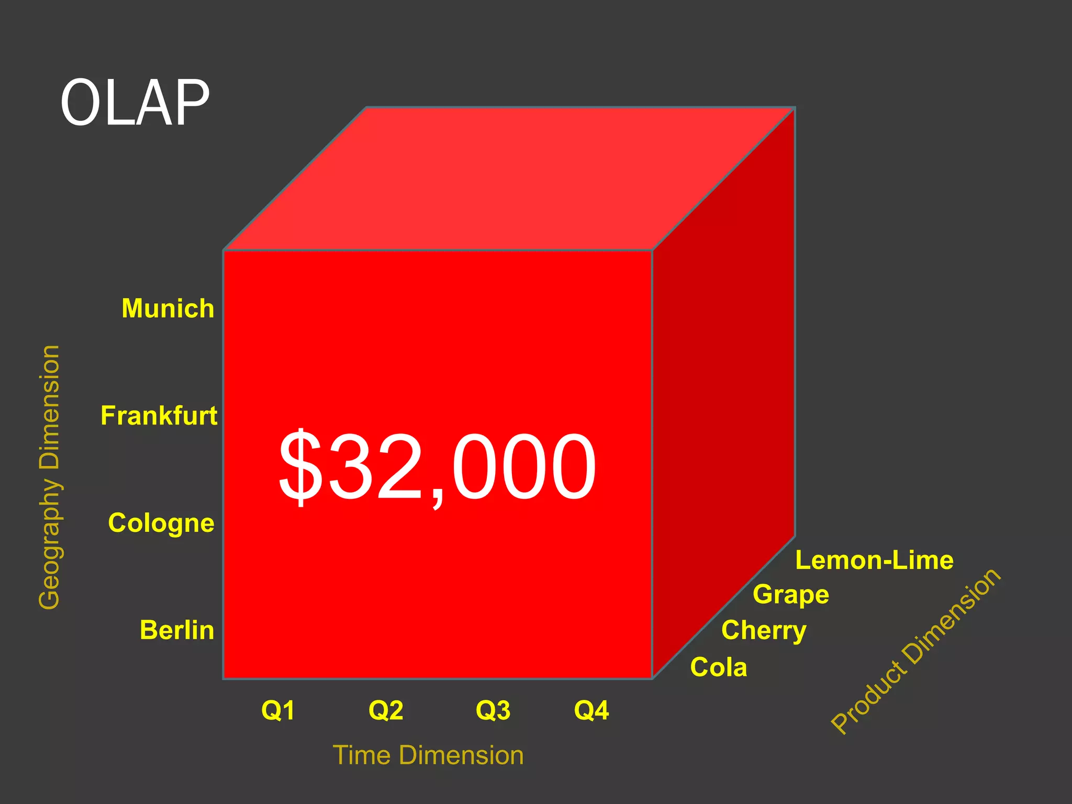

Slide 57
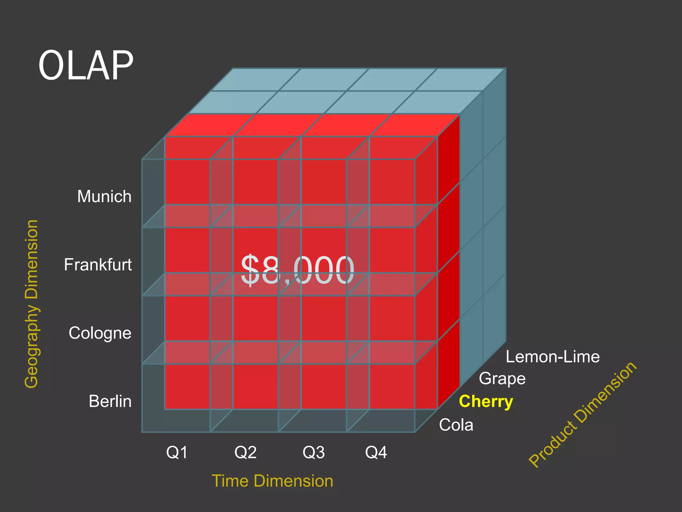

Slide 58
Hierarchies
Hierarchies lets you drill-down into data to explore interesting patterns and anomalies
Hierarchy organizes data by levels
Examples include:
Monthly data rolls up to quarters and years
Cities roll up to regions and states
2024
Q1
Q2
Q3
Q4
JAN
FEB
MAR
APR
MAY
JUN
JUL
AUG
SEP
OCT
NOV
DEC

Slide 59
Hierarchies
For example, in a typical analysis task you would:
Units sold, Average price, Sales
100 products
24 months
200 areas
Total data points would total 1,440,000!
2024
Q1
Q2
Q3
Q4
JAN
FEB
MAR
APR
MAY
JUN
JUL
AUG
SEP
OCT
NOV
DEC

Slide 60
Hierarchies
This multi-dimensional analysis process becomes manageable because a hierarchical organization of each dimension lets you start at the top of the hierarchy and lets you drill down through data as you see interesting patterns.
2024
Q1
Q2
Q3
Q4
JAN
FEB
MAR
APR
MAY
JUN
JUL
AUG
SEP
OCT
NOV
DEC

Slide 61
Hierarchies
This top-down analysis approach is similar to “20 questions game”
You start by asking broad questions
Then, depending on the answers you ask increasingly focused questions
2024
Q1
Q2
Q3
Q4
JAN
FEB
MAR
APR
MAY
JUN
JUL
AUG
SEP
OCT
NOV
DEC

Slide 62
Summary
Data analytics systems analyze online data collected by transaction processing systems, along with data collected from other sources, to help people make business decisions. Decision-support systems come in various forms, including OLAP systems.
Data warehouses help gather and archive important operational data. Warehouses are used for decision support and analysis on historical data, for instance, to predict trends. Data cleansing from input data sources is often a major task in data warehousing. Warehouse schemas tend to be multidimensional, involving one or a few very large fact tables and several much smaller dimension tables.

Slide 63
Summary
Online analytical processing (OLAP) tools help analysts view data summarized in different ways, so that they can gain insight into the functioning of an organization.
OLAP tools work on multidimensional data, characterized by dimension at- tributes and measure attributes.
The data cube consists of multidimensional data summarized in different ways. Precomputing the data cube helps speed up queries on summaries of data.
Cross-tab displays permit users to view two dimensions of multidimensional data at a time, along with summaries of the data.
Drill down, rollup, slicing, and dicing are among the operations that users per- form with OLAP tools.
The SQL standard provides a variety of operators for data analysis, including cube, rollup, and pivot operations.

